Slide 1
Data Rich Drug Take-Back Events
Increasing capacity while enriching data

Slide 2
Introduction
More webinars to come with funding from BlueCross BlueShield of TN. Save the Date: Webinars will be the 2nd Wednesday of every month
Submit your locations to slee@ccantidrug.org for statewide coverage.

Slide 3
More than meets the eye…or pound.
Does weighing the pills give an accurate picture of the goals for a drug take back event?
Are we accurately weighing?
Defining “Pure” Pill Poundage
Separating pills from the bottles and liquids allows for a “pure” pill weight. This is a more accurate reflection of the amount of pills being collected.
Note: Blister packs of pills do not need to be separated.

Slide 4
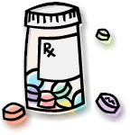
The Final Tally Why is counting abusables important?
Why?
Who?
Data directly relevant to the prescription drug epidemic
More understandable/relatable to the public at large
Allows tracking of prescribing practices locally
Uncovers trends
Pharmacists
Need Assistance?
Tennessee Pharmacists Association
ETSU
Belmont
Nurses
Adult volunteers
- provide wifi (www.drugs.com)
- DEA pill identifier
Notes:
Why? Value Added

Slide 5
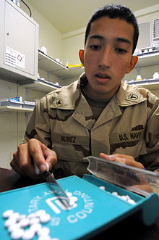
How?
Set-Up
Procedure
Tracking Sheet
Notes:
Pull up tracking sheet

Slide 6
Participant Surveys
Quick and easy
Great for youth involvement
Tracks demographics and media
Evaluates behavior
Notes:
Show participant survey

Slide 7
Reporting
For Count It! Lock It! Drop It! Communities:
Take-back event data due:
October 26, 2016 for the event on October 22, 2016
PIRE will compile and evaluate – Just submit the surveys, tracking sheets, etc.
Want to be involved:
Become a CLD Community
And/Or
Submit your counts as well to be included in the statewide report and media pushes
Submit data to Stacy Lee: slee@ccantidrug.org
Mail surveys to:
122 McMinnville Hwy
Manchester, TN 37355

Slide 8
Thank You
Contacts Information:
Christina Merino
cmerino@ccantidrug.org
Kristina Clark
kclark@ccantidrug.org
Stacy Lee
slee@ccantidrug.org

