Slide 1
Media Relations and Social Media Engagement

Slide 2
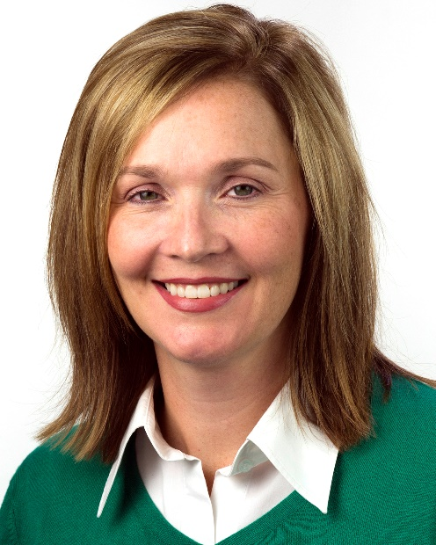
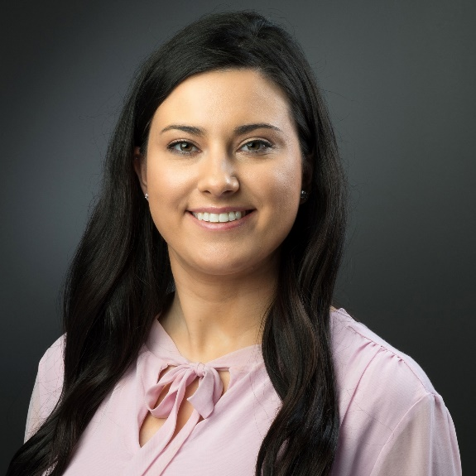
Today’s Presenters
Jennifer Brantley
Senior Vice President
jbrantley@mpf.com
Angela Argiro
Staff Associate
aargiro@mpf.com
615-259-4000

Slide 3
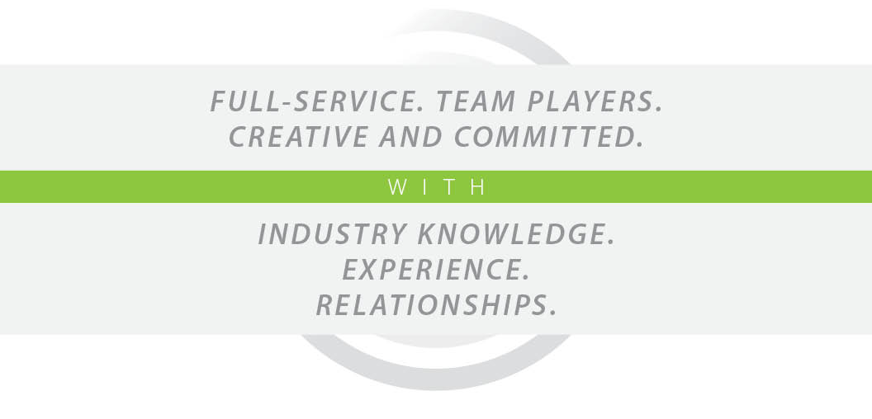
WHO WE ARE

Slide 4
Agenda
Media Relations
Writing effective news releases
Media outreach
Social Media
Building an online presence
Advertising
Monitoring and tracking
Questions

Slide 5
Media Relations

Slide 6
Writing Effective News Releases
Ask: Do I need to write a news release?
Can I get a reporter interested by sending him/her a pitch via email?
Can I get a reporter interested by writing the pitch in a quick, easy-to-read memo?
Releases need to answer the following questions:
Who? What? When? Where?
Why would a reporter be interested in using the release?
Why would a reader be interested in seeing this in the newspaper, on TV or hearing about it on the radio?

Slide 7
Sample News Release

Slide 8
Elements of a News Release
Headline: Grabs your attention – makes the reader want to continue
Clearly convey the essence of what the news release is about
Headline
Lead
Lead: Introductory section of a release intended to entice the reader to read the full story
Includes the most important details
No more than two or three sentences

Slide 9
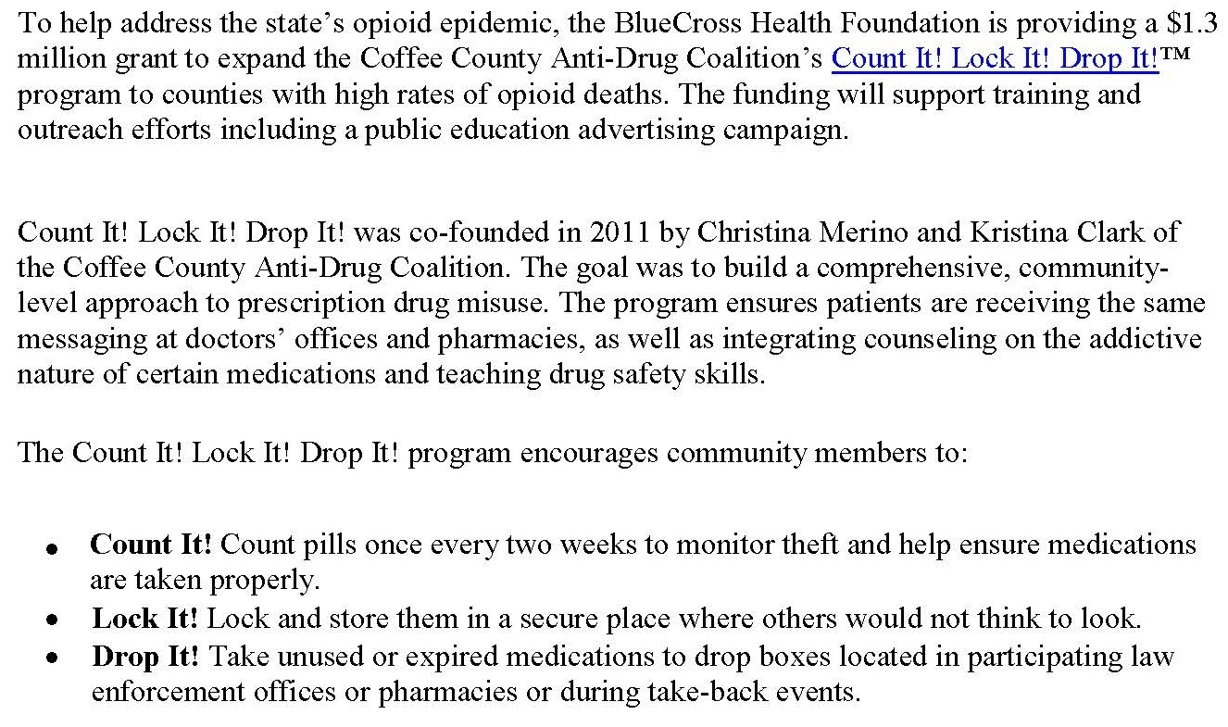
Elements of a News Release
Body: Gives credibility to story by citing sources, data and answers “So what?” “How?”
What
Credibility
How

Slide 10
Elements of a News Release
Quote: Adds a human touch; keeps it conversational
Issue
BCBST
CLD

Slide 11
Elements of a News Release
Wrap up: Where reader can get more information
Website

Slide 12
Writing Effective News Releases
Additional elements:
Visuals – photos, video, graphics, infographics
Boilerplate – consistent description about your organization
Boilerplate

Slide 13
Media Relations: Media List
Develop a media list
Which reporters might be interested in your story?
Track your outreach
Audit your media list

Slide 14
Media Relations: Know Your Reporters
Get to know the reporters on your media list
Read, watch, listen
Follow them

Slide 15
Media Relations: Schedule a Meeting
Set up an introductory meeting
What types of stories they want to cover
Best way to get them information
Preferred method of contact (phone or email)
Good time/bad time to contact with story ideas or pitches
Deadline

Slide 16
Media Relations: Build a Relationship
Contact them when you don’t have a story to pitch
Provide feedback on stories you enjoy
Share a tip or source unrelated to your organization
Coffee or lunch

Slide 17
Media Relations: Honor the Relationship
Pitch stories you know they would find interesting
Not all stories are “good stories”
Remember to ask:
Why would a reporter be interested in this story?
Will people in my community be interested in this story?
If you think, “Why am I asking this reporter to cover this?” then you probably shouldn’t pitch it

Slide 18
We’re Here To Help
Our focus
Nashville: The Tennessean/TV
Knoxville: The News Sentinel/TV
Memphis: The Commercial Appeal/TV
Need human interest stories
Template media materials
Releases – add local information, quote
Op-Eds – add local information, local author

Slide 19
Social Media

Slide 20
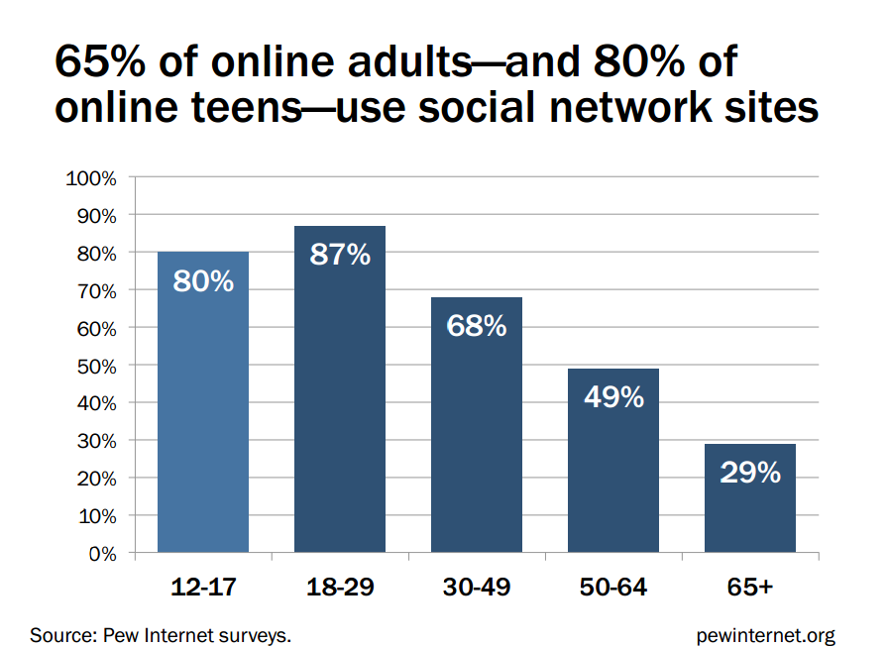
Social Media: By the Numbers

Slide 21
Social Media: Pick Your Platforms

Slide 22
Social Media: Building an Online Presence
Be intentional
Think through content in advance
Look to Count It! Lock It! Drop It!TM and other anti-drug coalitions for inspiration and ideas

Slide 23
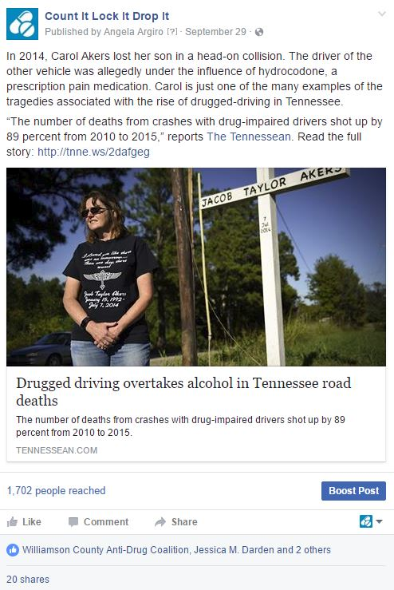
Social Media: Facebook
Audience:
(Almost) everyone!
Content:
Videos, links, photos, text and hashtags
Frequency:
Three to five times per week
Tip:
Post during the workday for more engagement

Slide 24
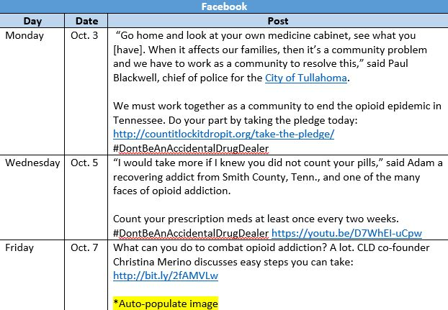
Social Media: Content Calendar

Slide 25
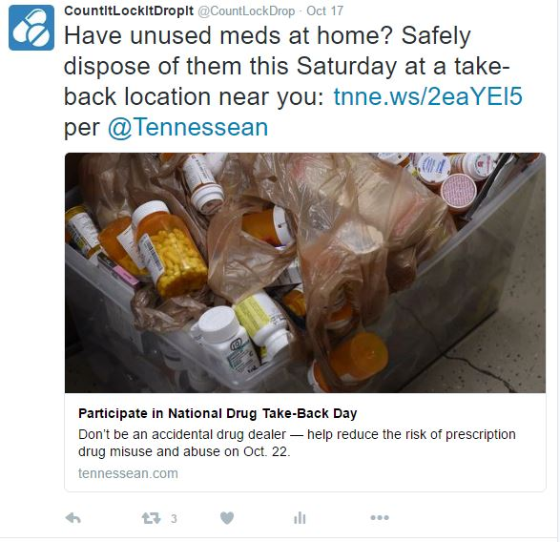
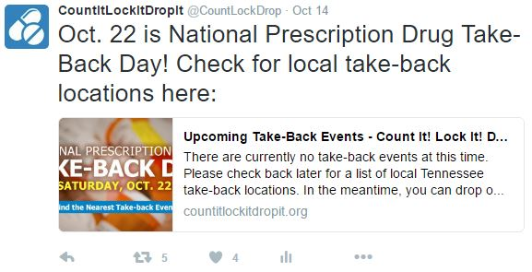
Social Media: Twitter
Audience:
Influencers (media, community leaders, etc.)
Content:
Text up to 140 characters, shortened links, hashtags
Frequency:
Three to five times per week
Tip:
Join the conversation with relevant hashtags and engage with other Twitter users by including their handles in posts

Slide 26
Social Media: Advertising

Slide 27
Social Media: Monitoring and Tracking

Slide 28
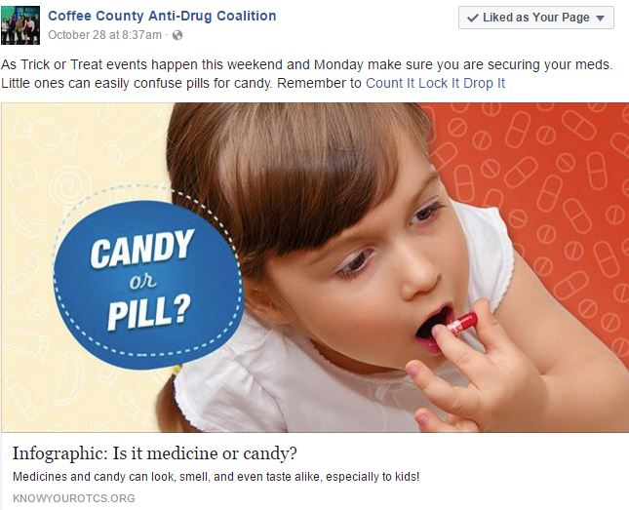
Social Media: Sharing Content
media@countitlockitdropit.org

Slide 29
Questions?

